Slide 1

Federated Learning
By: Sohail Ahmed Malik
Amjad Saeed

Slide 2
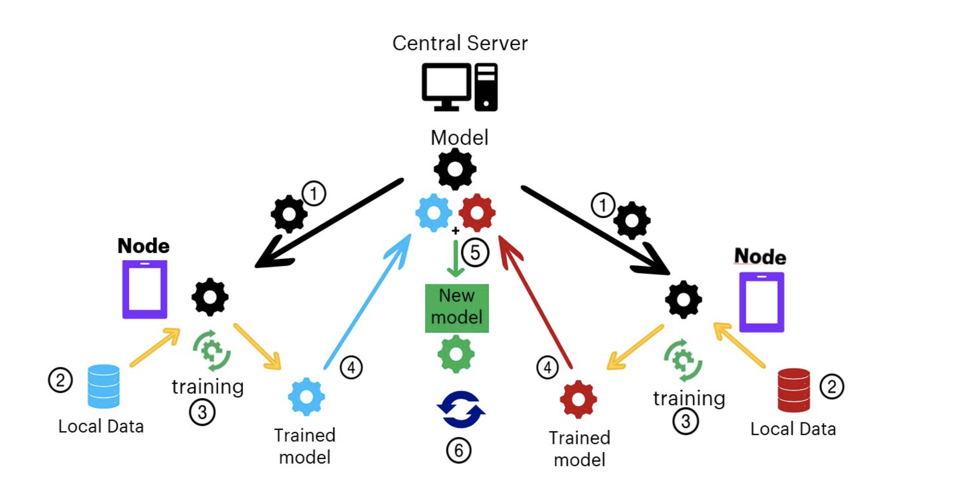

Slide 3
PROBLEM STATEMENT
Suppose, you got selected as a machine learning intern in a company, and your task is to create a robust machine learning application, that needs to train itself on user-sensitive data.
You’re allowed to extract user data, aggregate it from many users, and stack them up on a centralized cloud server, for your model to crunch it. You are a smart guy, and you are doing your job!

Slide 4
STEPS
Our centralized machine learning application will have a local copy on all devices, where users can use them according to our need.
The model will now gradually learn and train itself on the information inputted by the user and become smarter, time to time.
The devices are then allowed to transfer the training results, from the local copy of the machine learning app, back to the central server.
Remember, only results, not data!
This same process happens across several devices, that have a local copy of the application. The results will be aggregated together in the centralized server, this time without user data.
The centralized cloud server now updates its central machine learning model from the aggregated training results, which is now far better than the previously deployed version.
The development team now updates the model to a newer version, and users update the application with the smarter model, created from their own data!

Slide 5
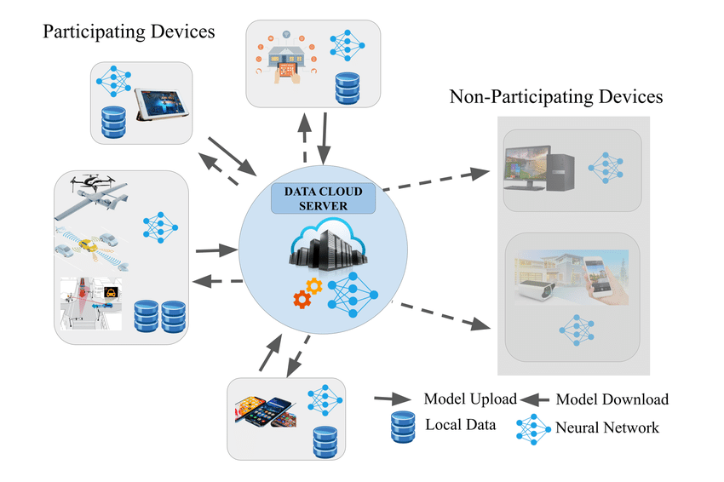

Slide 6
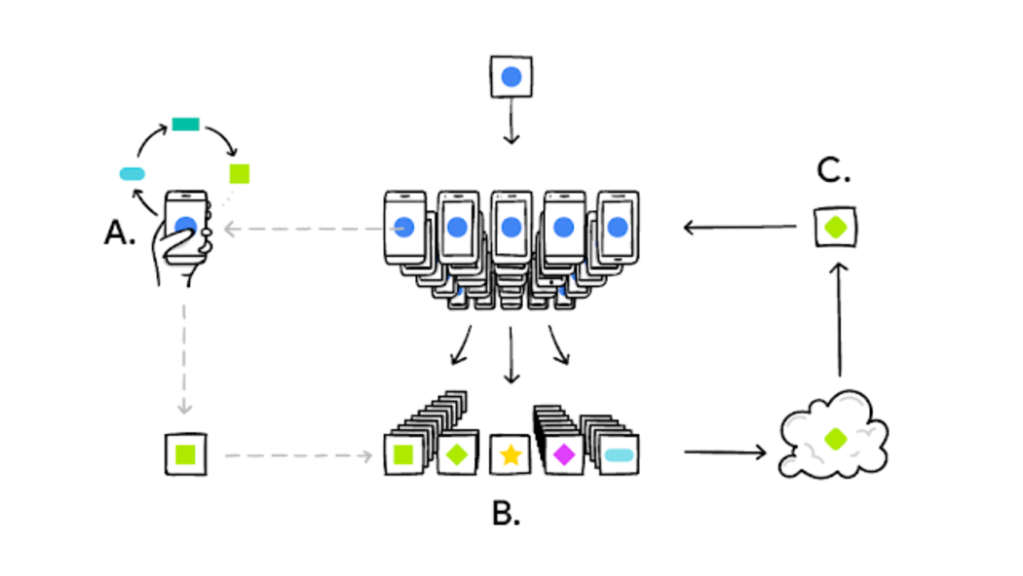
Federated Learning — a Decentralized Form of Machine Learning
A user’s phone personalizes the model copy locally, based on their user choices (A). A subset of user updates are then aggregated (B) to form a consensus change (C) to the shared model. This process is then repeated.

Slide 7

Applications of Federated Learning

Slide 8
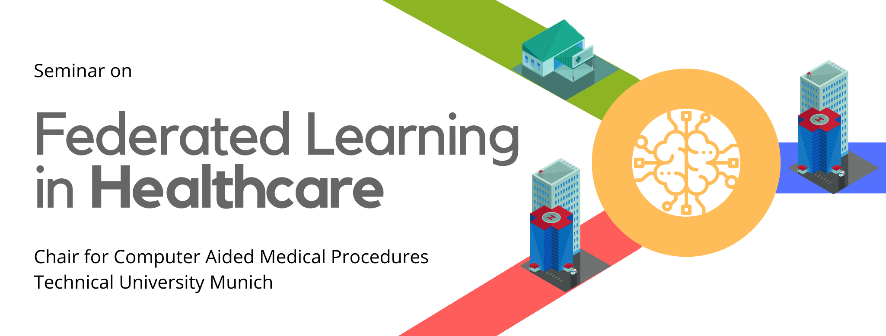
FL is a new concept and approach to machine learning. It has immense potential to transform the healthcare industry. It can reap more benefits for healthcare professionals too. FL does not intend to replace healthcare professionals. It wants to allow them to divert their energies for better patient care

Slide 9
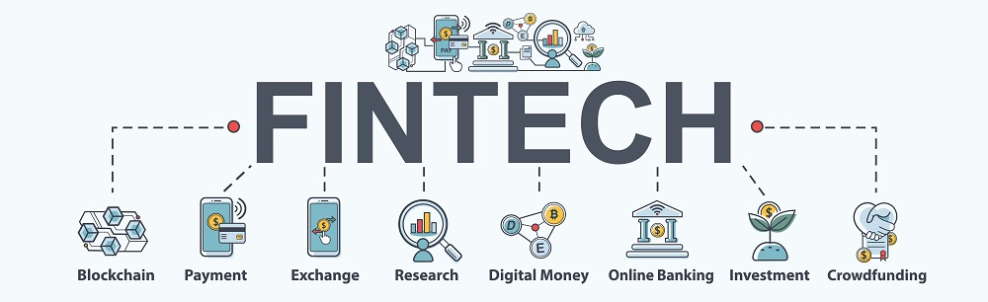
With traditional ML, businesses dependent on FinTech face several issues. These include getting clearance and lawful consent as well as the preservation of the data and the time and cost in collecting and transferring data across networks
. Here, FL provides a simple solution. That is, by keeping the data local, we can use edge devices and edge computing power.

Slide 10


Slide 11
Fraudulent activities often occur. When an insured violates the insurance company’s trust by making false claims. The individual or business can be accountable for fraud and illicit activity.
So the question arises, how do we train Machine Learning algorithms with different data sets when you cannot share them between organizations or even between locations?
Federated Learning aims to resolve this very issue.
Here without violating the data clause, a company could identify its users’ patterns. It prevents fraudulent or wrongful activity by introducing Federal Learning. The algorithms could train and govern according to the data. And not violate the insured’s confidentiality.

Slide 12
Federated Learning Applications in IoT
Federated learning aims to secure the data collected through different mediums. It also keeps vital information local.
FL is a solution that allows on-device machine learning without transferring the user’s private data to a central cloud.
Hence, federated learning can help achieve personalization. As well as enhance the performance of devices in IoT applications

Slide 13
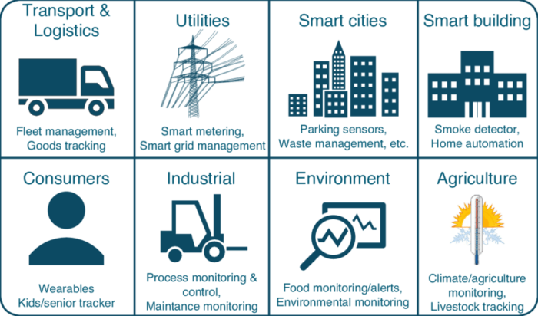

Slide 14

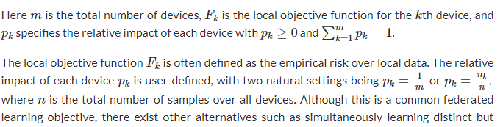
Challenges in federated learning
Problem formulation

Slide 15
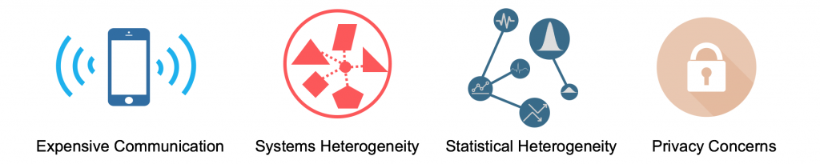
How does federated learning differ from classical distributed learning in data center environments?

Slide 16
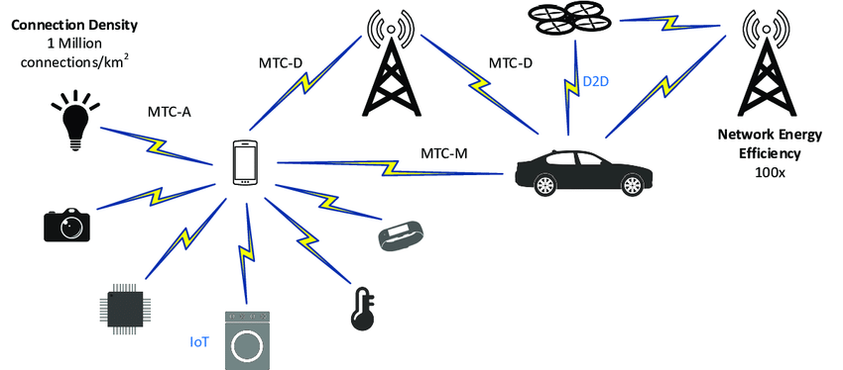
Challenge 1: Expensive Communication
Federated networks are potentially comprised of a massive number of devices (e.g., millions of smart phones), and communication in the network can be slower than local computation by many orders of magnitude.

Slide 17
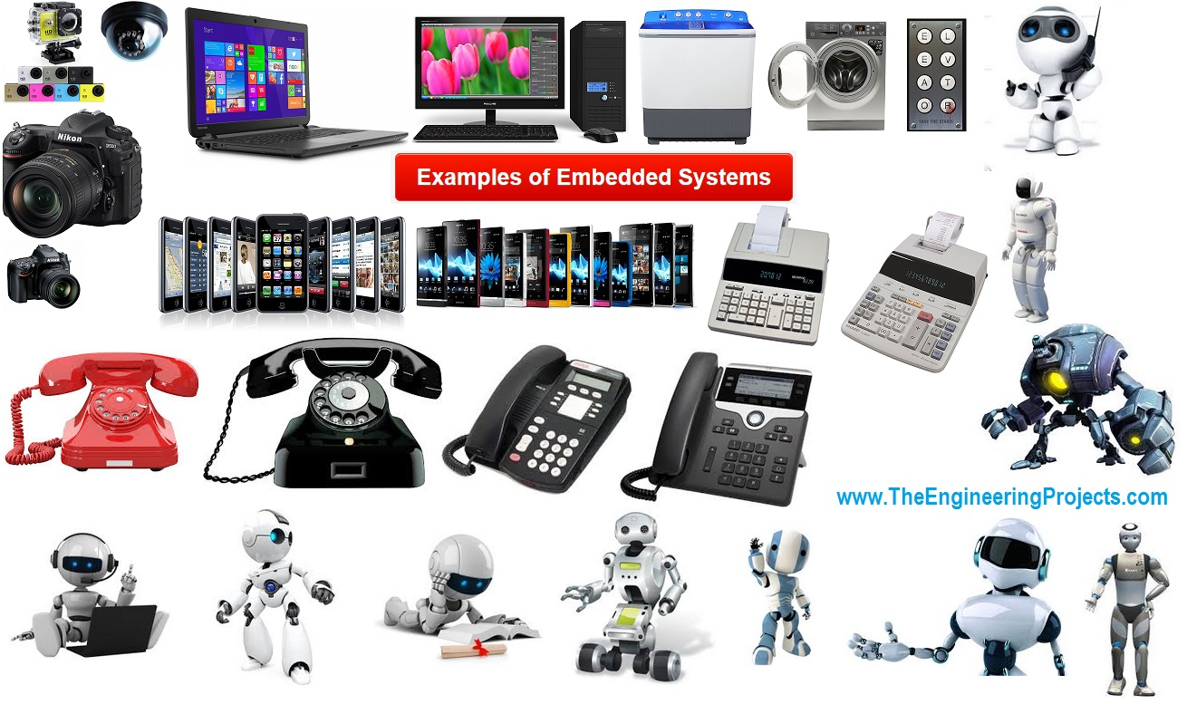
Challenge 2: Systems Heterogeneity

Slide 18
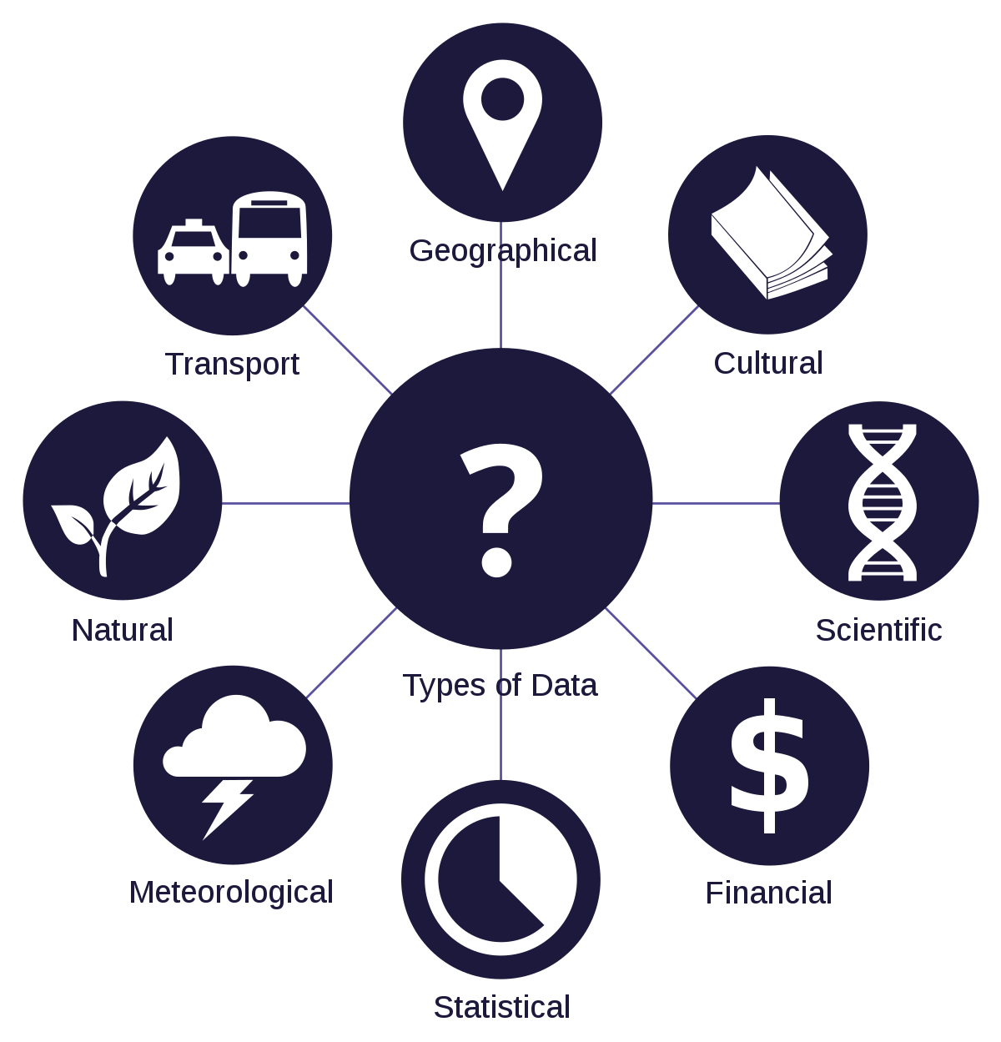
Challenge 3: Statistical Heterogeneity

Slide 19

Challenge 4: Privacy Concerns

